Slide 1
Lecture 3
Introduction to OpAmp

Slide 2
Review
Last class: alternative representation, KCL, KVL, nodal
Today: review of dependent source, introduction to amplifiers, operational amplifiers

Slide 3
Dependent Source
Active sources – either voltage of current source
Difference: voltage (or current) controlled by the voltage/current in a different branch
Technically non-linear devices – because in real life, dependent sources are made using non-linear electronic devices (e.g. MOSFET)
However, analysis are similar to linear circuits (CSE250), hence we will start with this

Slide 4
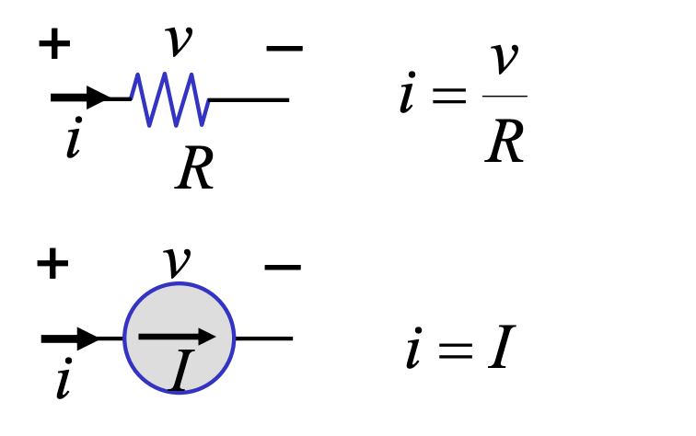
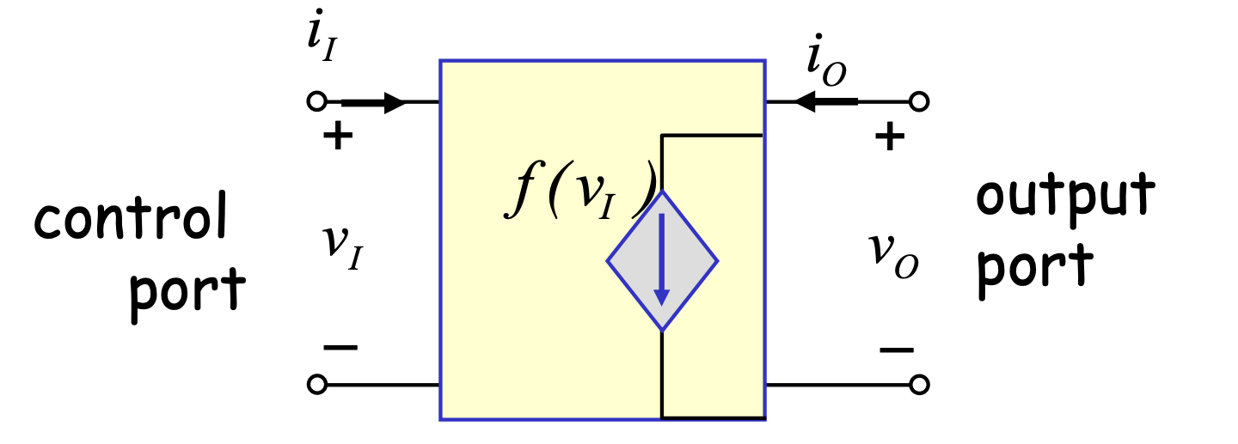
Major Difference
Independent devices:
Dependent devices:
2 terminals, 1 port
2 terminals, 2 port

Slide 5
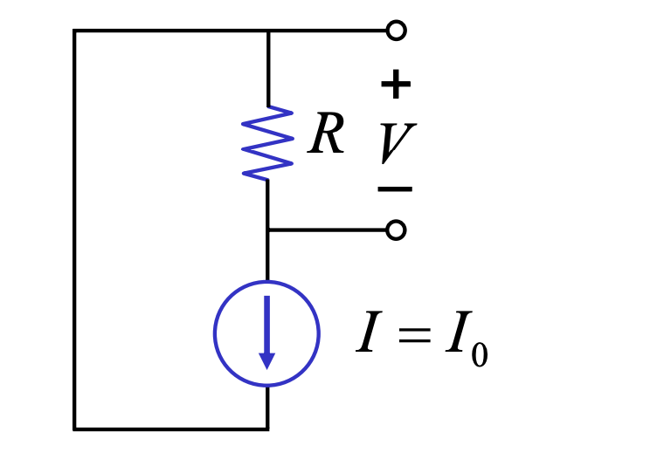
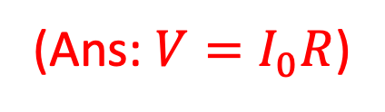
Example 1
Find V
(Ans: $V=I_{0}R$)

Slide 6
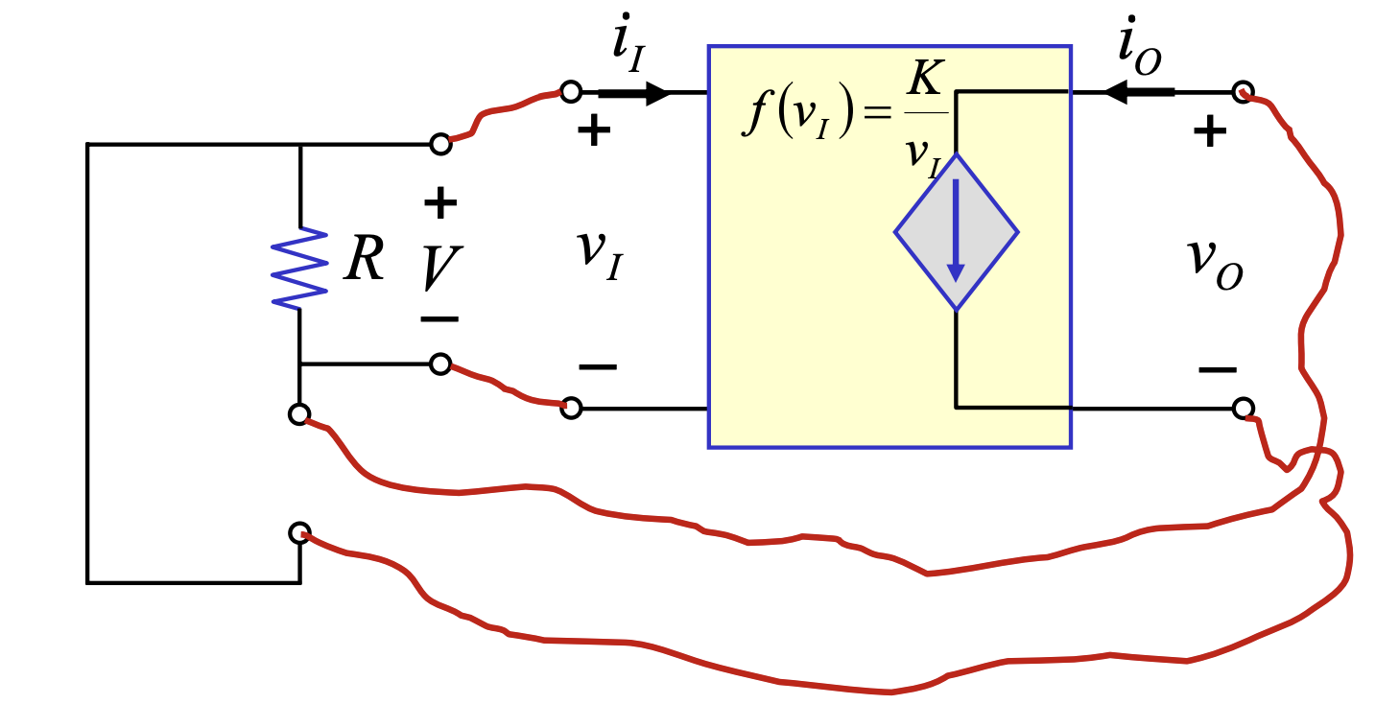
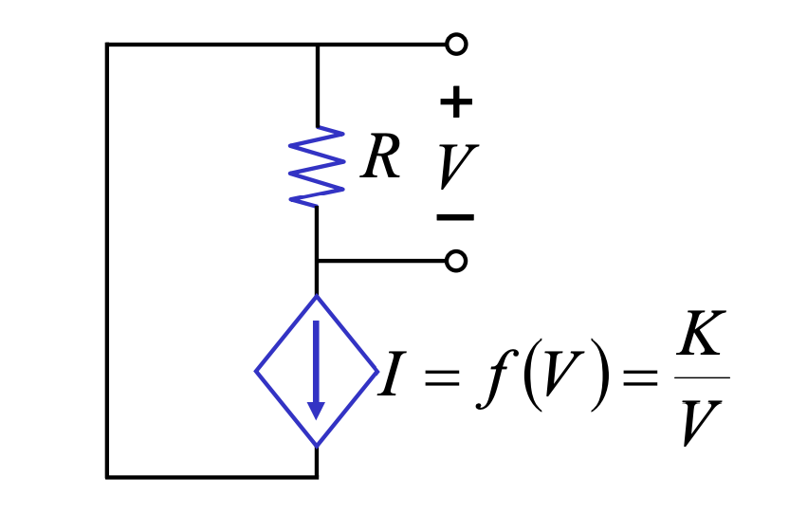
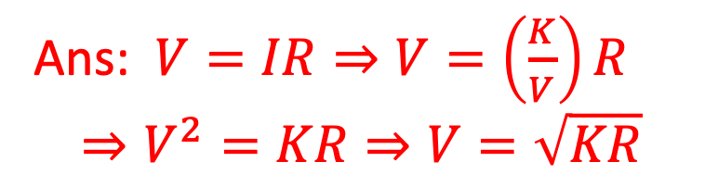
Example 2
Ans: $V=IR⇒V=\left(\frac{K}{V}\right)R$ $$⇒V^{2}=KR⇒V=\sqrt{KR}$$
Find V
Application of dependent sources: amplifiers!

Slide 7
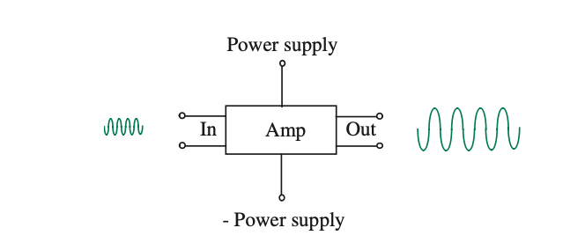
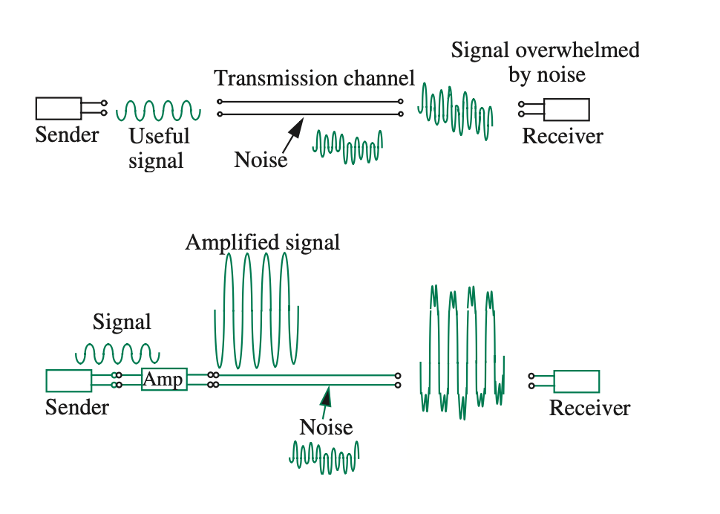

Amplifier
Linear amplifier $⇒OUT=k×IN$. $k$ is called the gain of the amplifier
OUT/IN can be voltage or current
Amplifier must provide power gain $(P_{OUT}>P_{IN})$, hence need power supply
Usage: communication

Slide 8
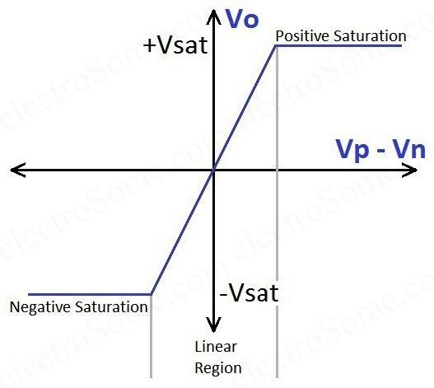
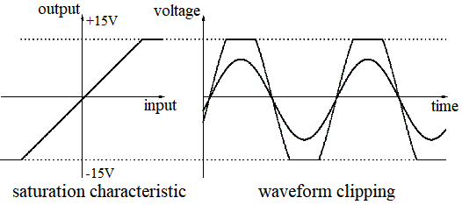
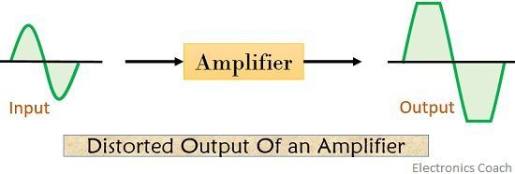

Transfer Characteristics of Amplifiers
$y=mx$, hence straight line going through origin. Here, $m=k=gain$
Saturation due to limited power supply. Output cannot be greater than P.S.
Input must be within a valid input range, otherwise output will be distorted
Amplifiers are non-linear devices, because they are made using dependent sources
OUT
IN

Slide 9
Operational Amplifiers
An operational amplifier, or op-amp for short, is a versatile and powerful integrated circuit that is widely used in a variety of electronic applications.
An Op-Amp is designed so that it performs some mathematical operations when external components, such as resistors and capacitors, are connected to its terminals.
The op amp is an electronic device consisting of a complex arrangement of resistors, transistors, capacitors, and diodes. A full discussion of what is inside the op amp is beyond the scope of this course. For now, it will suffice to treat the op amp as a circuit building block and simply study what takes place at its terminals.

Slide 10
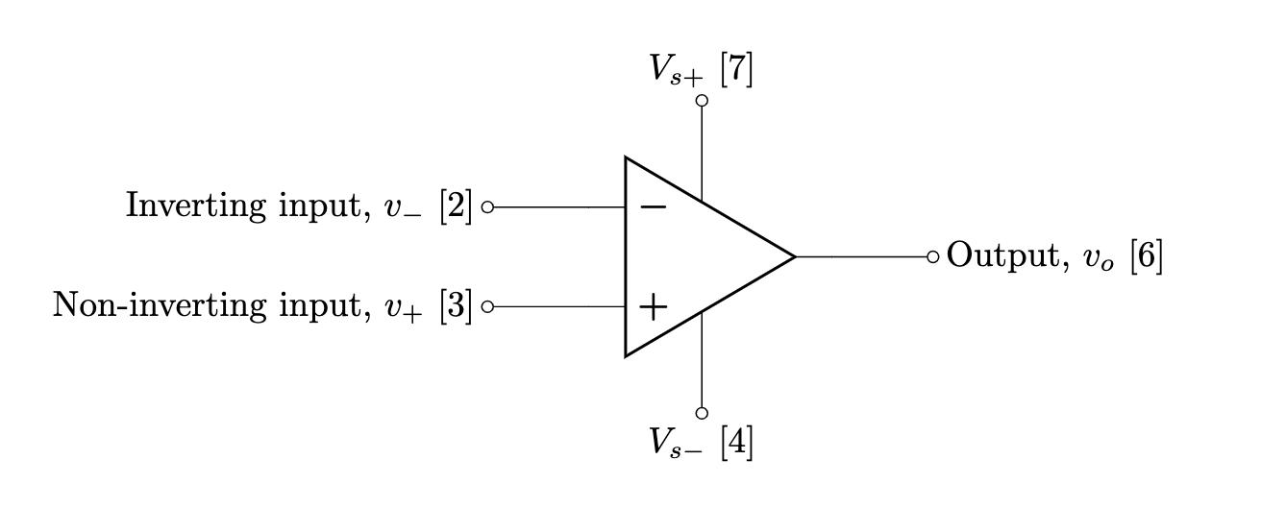
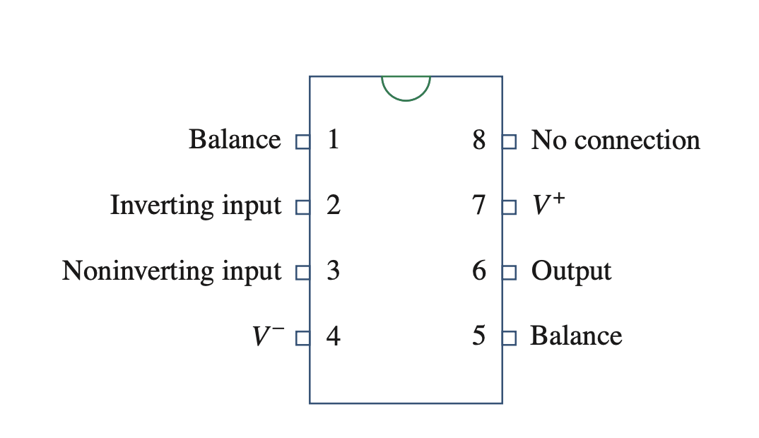
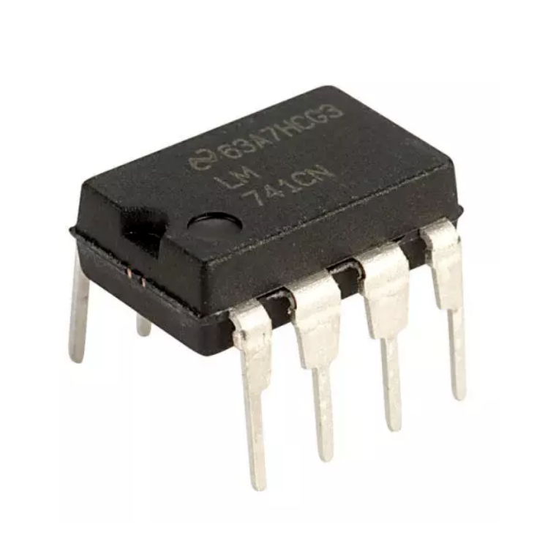
Terminals and Circuit Symbol
Op-amps are differential amplifiers – meaning it amplifies the voltage difference between two terminals. Therefore, it has two inputs
Since this is an amplifier, there are two terminals for power supply

Slide 11
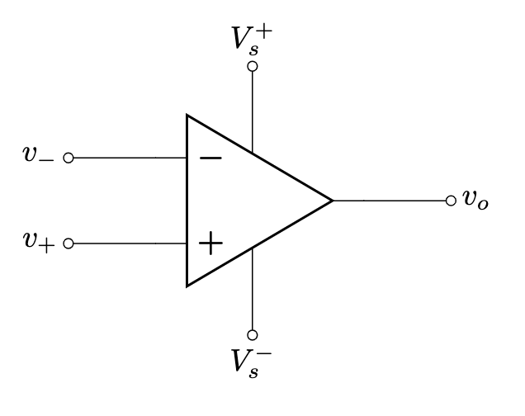
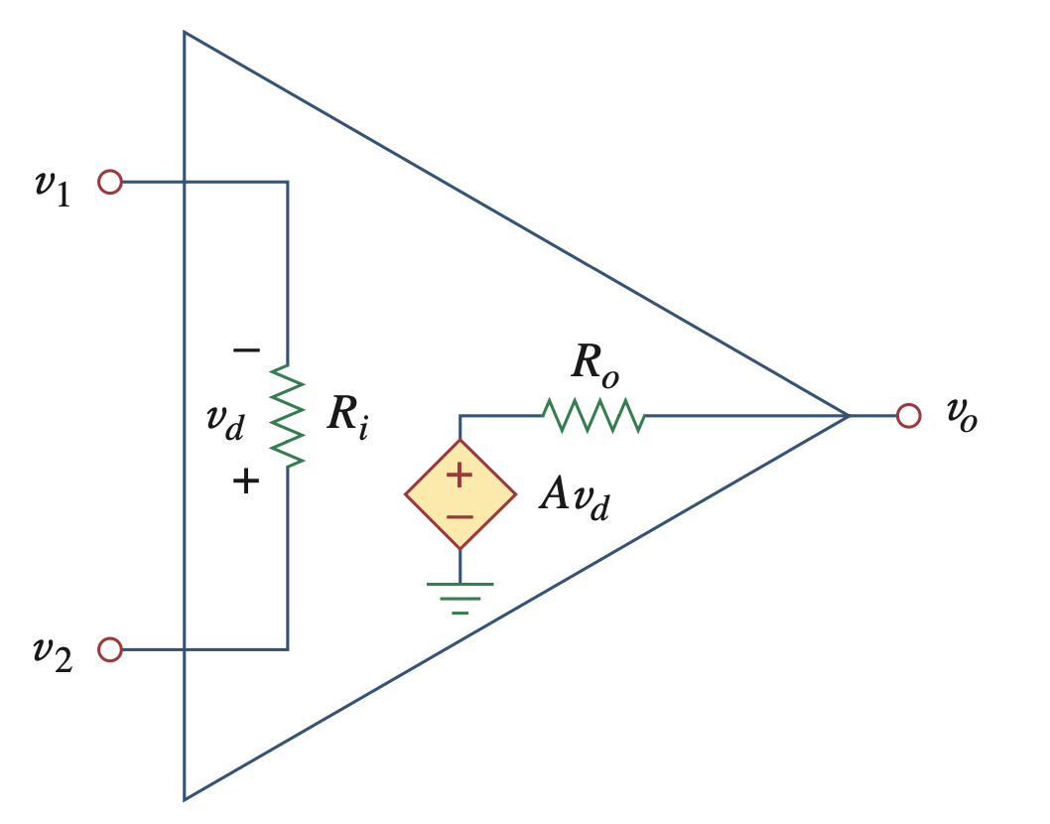
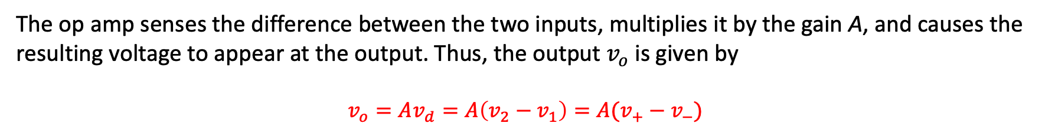

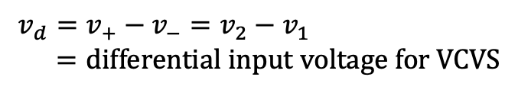



Equivalent Circuit
Since op amp is an amplifier, the internal circuit can be modeled using a voltage controlled voltage source (VCVS)! (actual circuit is complicated)
$$v_{1}=v_{−}=voltage of inverting terminal$$
$$v_{2}=v_{+}=voltage of noninverting terminal$$
$$v_{d}=v_{+}−v_{−}=v_{2}−v_{1} \\ =differential input voltage for VCVS$$
$$A=Open loop gain$$
$$R_{i}=Input resistance$$
$$R_{o}=Output resistance$$
The op amp senses the difference between the two inputs, multiplies it by the gain A, and causes the resulting voltage to appear at the output. Thus, the output $v_{o}$ is given by
$$v_{o}=Av_{d}=A\left(v_{2}−v_{1}\right)=A(v_{+}−v_{−})$$

Slide 12


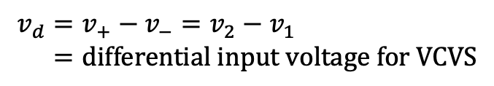
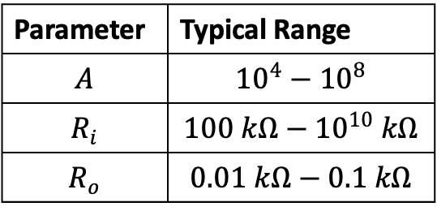
Equivalent Circuit
Since op amp is an amplifier, the internal circuit can be modeled using a voltage controlled voltage source (VCVS)! (actual circuit is complicated)
$$v_{1}=v_{−}=voltage of inverting terminal$$
$$v_{2}=v_{+}=voltage of noninverting terminal$$
Parameter | Typical Range
$$A$$ | $${10}^{4}−{10}^{8}$$
$$R_{i}$$ | $$100 kΩ−{10}^{10} kΩ$$
$$R_{o}$$ | $$0.01 kΩ−0.1 kΩ$$
$$v_{d}=v_{+}−v_{−}=v_{2}−v_{1} \\ =differential input voltage for VCVS$$
$$A=Open loop gain$$
$$R_{i}=Input resistance$$
$$R_{o}=Output resistance$$
The op amp senses the difference between the two inputs, multiplies it by the gain A, and causes the resulting voltage to appear at the output. Thus, the output $v_{o}$ is given by
$$v_{o}=Av_{d}=A\left(v_{2}−v_{1}\right)=A(v_{+}−v_{−})$$

Slide 13
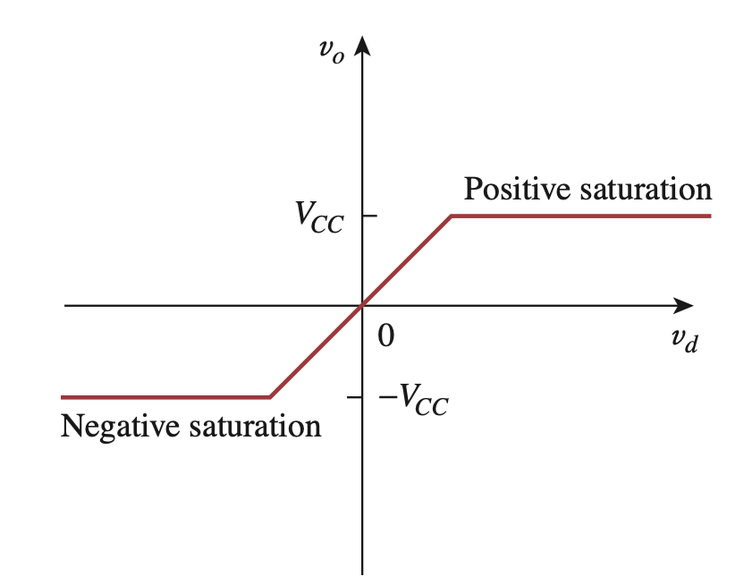
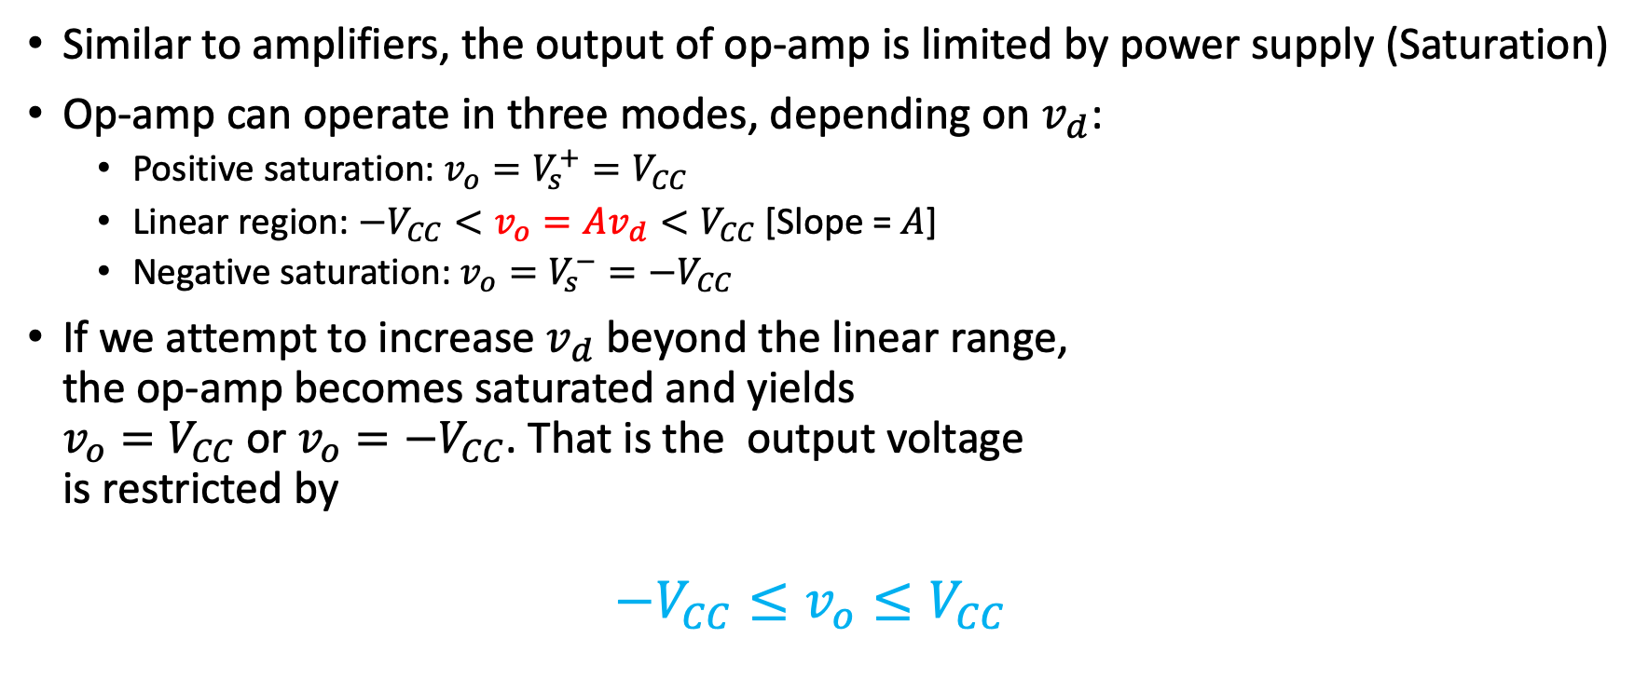
Practical Limitation - Saturation
Similar to amplifiers, the output of op-amp is limited by power supply (Saturation)
Op-amp can operate in three modes, depending on $v_{d}$:
Positive saturation: $v_{o}=V_{s}^{+}=V_{CC}$
Linear region: $−V_{CC}<v_{o}=Av_{d}<V_{CC}$ [Slope = $A$]
Negative saturation: $v_{o}=V_{s}^{−}=−V_{CC}$
If we attempt to increase $v_{d}$ beyond the linear range, the op-amp becomes saturated and yields $v_{o}=V_{CC}$ or $v_{o}={−V}_{CC}$. That is the output voltage is restricted by $−V_{CC}≤v_{o}≤V_{CC}$

Slide 14
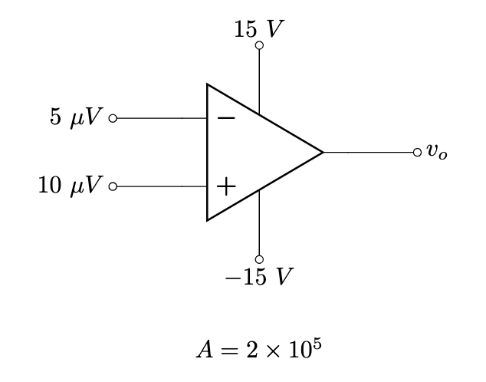

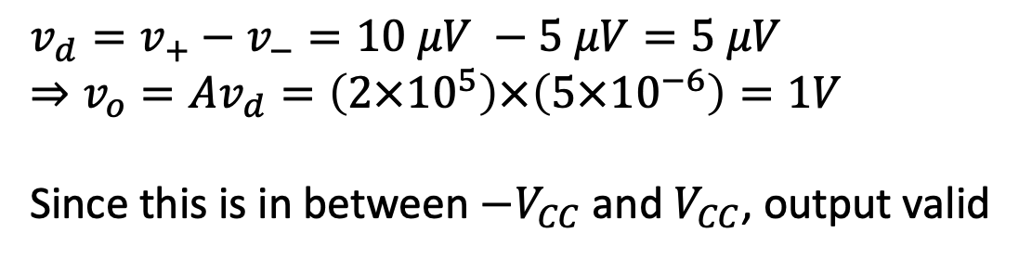
Example 3
Find $v_{o}$
Solution:
$$v_{d}=v_{+}−v_{−}=10 μV −5 μV=5 μV$$
$$⇒v_{o}=Av_{d}=\left(2×{10}^{5}\right)×\left(5×{10}^{−6}\right)=1V$$ Since this is in between $−V_{CC}$ and $V_{CC}$, output valid

Slide 15
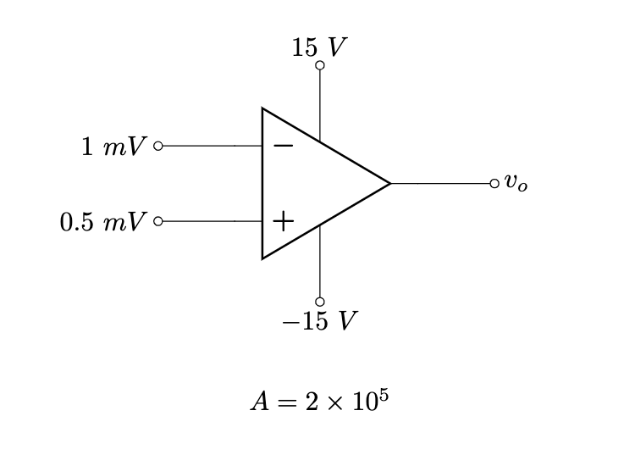
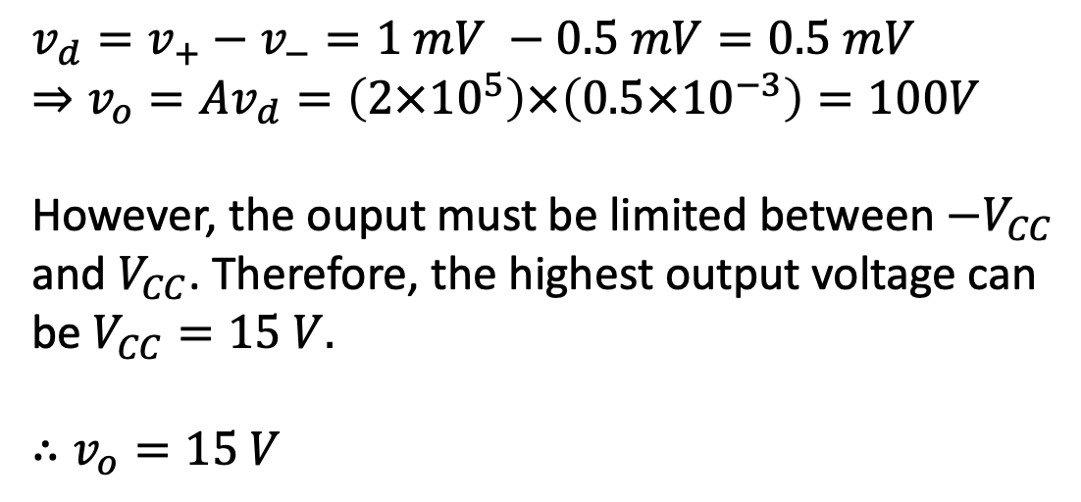
Example 4
Find $v_{o}$
Solution:
$$v_{d}=v_{+}−v_{−}=1 mV −0.5 mV=0.5 mV$$
$$⇒v_{o}=Av_{d}=\left(2×{10}^{5}\right)×\left(0.5×{10}^{−3}\right)=100V$$ However, the ouput must be limited between $−V_{CC}$ and $V_{CC}$. Therefore, the highest output voltage can be $V_{CC}=15 V.$
$$∴v_{o}=15 V$$

Slide 16
Solving Circuit with Op-Amp
Don’t be scared! Circuit solving with op-amp is exactly same as the circuits you solved in CSE250
Step 1: replace with equivalent circuit
Step 2: solve using KCL & KVL, or nodal analysis (linear)
In most cases, the power supply voltages are not mentioned. Hence, we will assume the ouput is within the linear range in this case

Slide 17
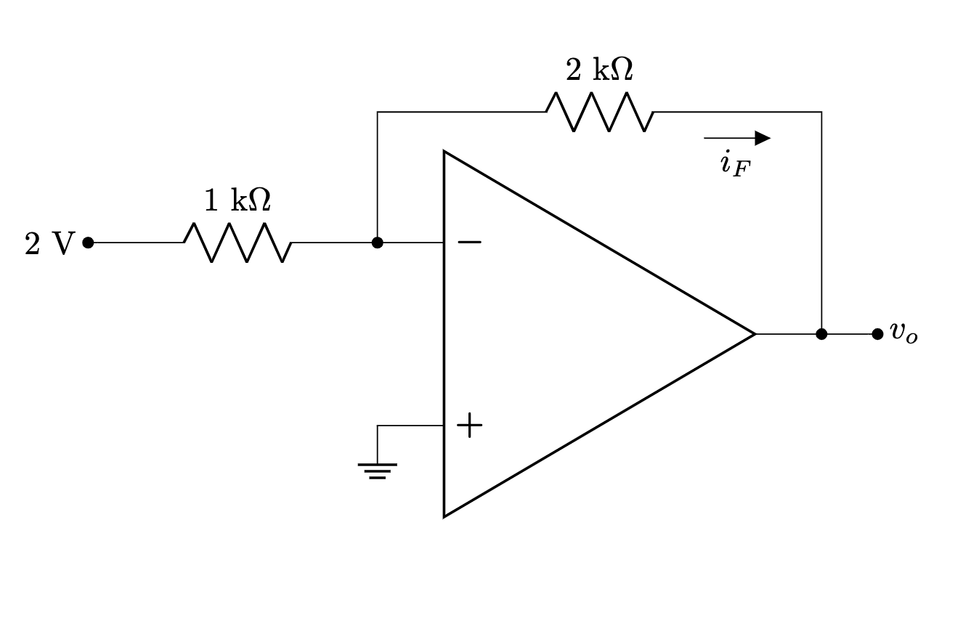
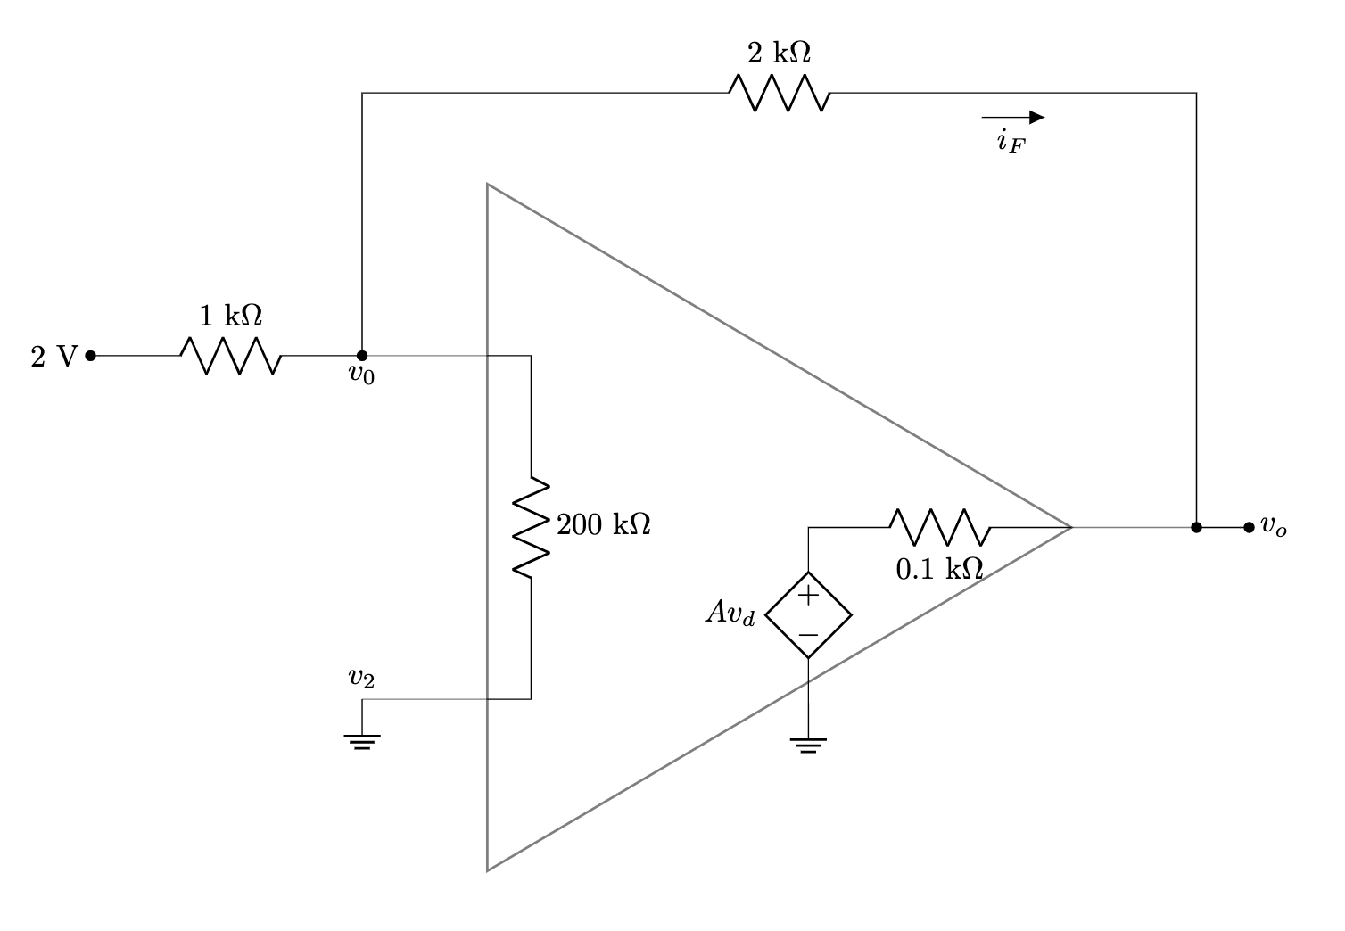
Example 5
Find $i_{F}$ and $v_{o}$. Here, $R_{i}=200 kΩ$, $R_{o}=0.1 kΩ$, $A=2×{10}^{5}$
Solution: Step 1: replace using equivalent circuit

Slide 18
Example 5
Step 2: Solve using KCL & KVL or nodal

Slide 19
Example 5
Step 2: Solve using KCL & KVL or nodal

Slide 20
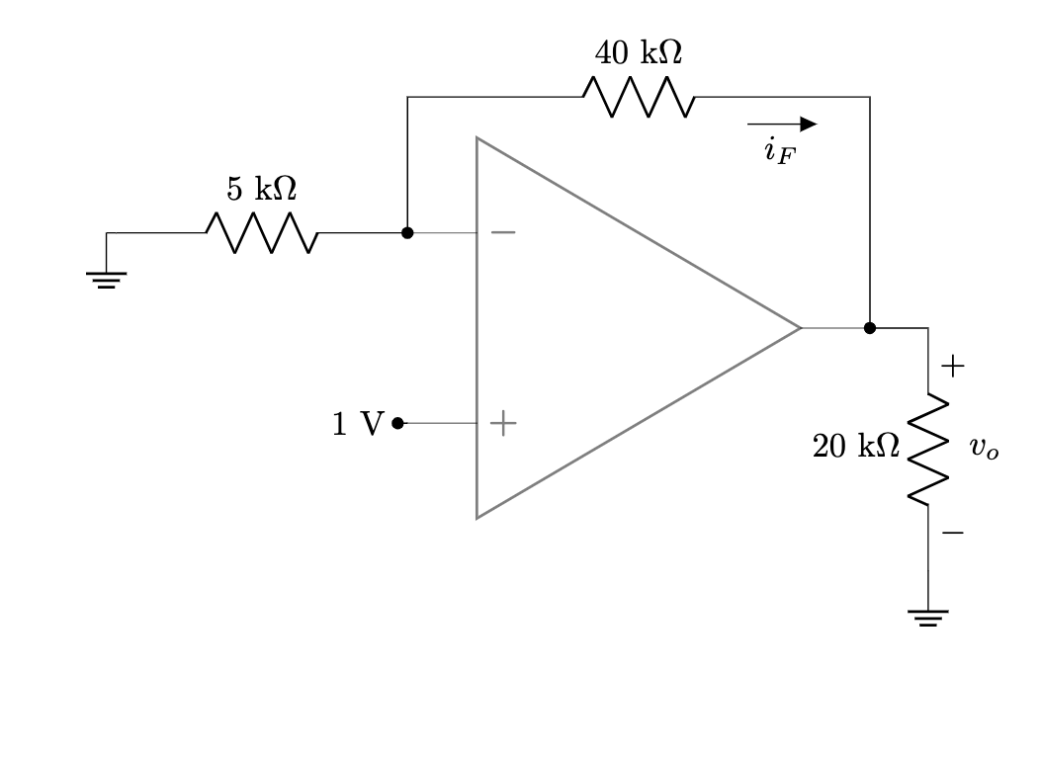
Example 6
Find $i_{F}$ and $v_{o}$. Here, $R_{i}=200 kΩ$, $R_{o}=0.1 kΩ$, $A=2×{10}^{5}$

Slide 21
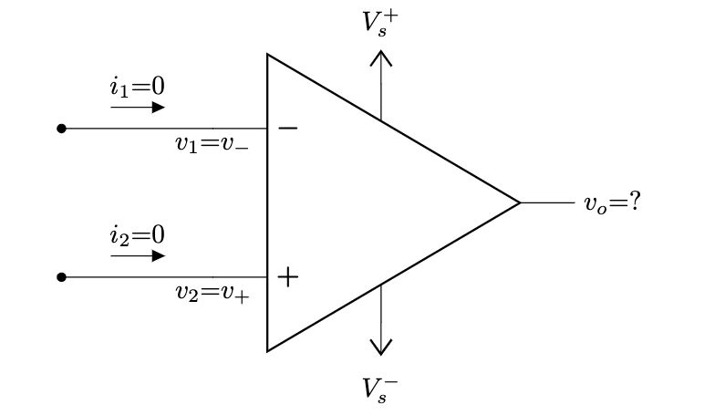

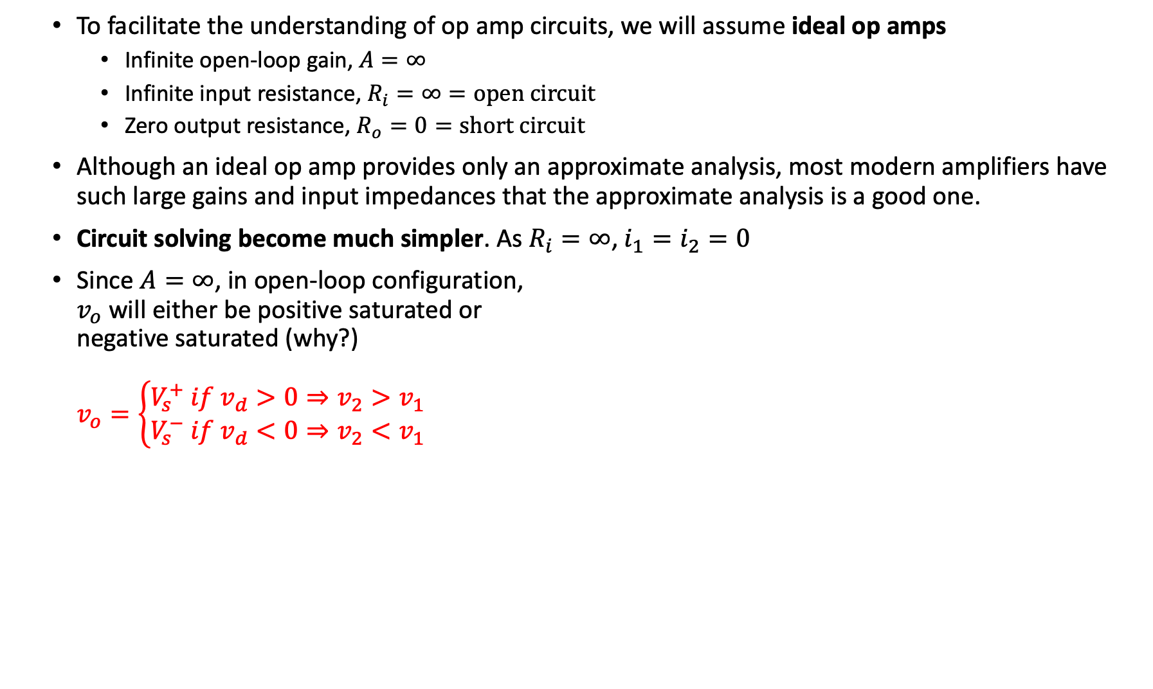




The Ideal Op-Amp
To facilitate the understanding of op amp circuits, we will assume ideal op amps
Infinite open-loop gain, $A=∞$
Infinite input resistance, $R_{i}=∞=open circuit$
Zero output resistance, $R_{o}=0=short circuit$
Although an ideal op amp provides only an approximate analysis, most modern amplifiers have such large gains and input impedances that the approximate analysis is a good one.
Circuit solving become much simpler. As $R_{i}=∞$, $i_{1}=i_{2}=0$
Since $A=∞$, in open-loop configuration, $v_{o}$ will either be positive saturated or negative saturated (why?) $v_{o}=\left\{\begin{aligned}V_{s}^{+} if v_{d}>0⇒v_{2}>v_{1} \\ V_{s}^{−} if v_{d}<0⇒v_{2}<v_{1}\end{aligned}\right.$
$$v_{o}$$
$$V_{s}^{+}$$
$$v_{d}$$
$$V_{s}^{−}$$
Reminder: $v_{d}=v_{2}−v_{1}=v_{+}−v_{−}$
VTC of ideal op amp

Slide 22
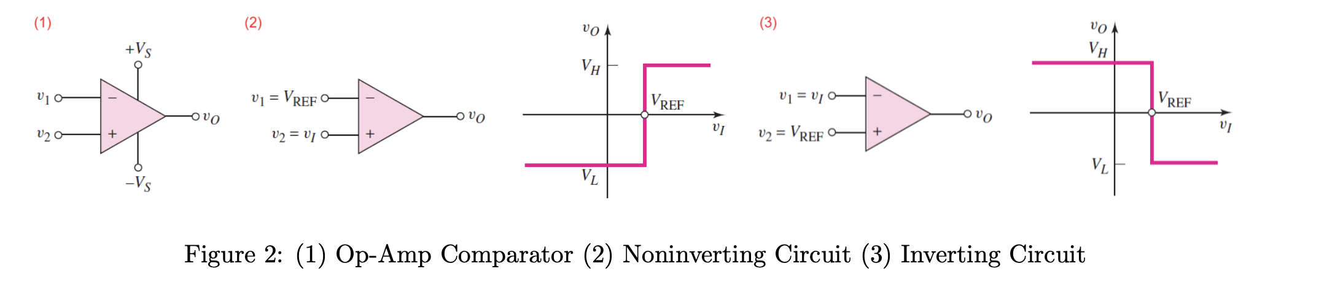

Application - Comparator
A comparator compares two voltages to determine which is larger.
The comparator is essentially an op-amp operated in an open-loop configuration
Two types –
(1) Non-inverting: outputs a positive voltage ($V_{H}=V_{s}^{+}$) when input is greater than reference
(2) Inverting: outputs a negative voltage ($V_{L}=V_{s}^{−}$) when input is greater than reference
Application – smoke detector, turning AC on/off automatically, etc (next lecture)

